Slide 1
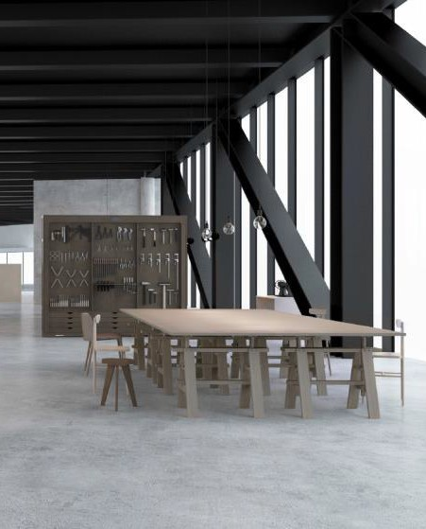

ABOUT DeArt
Founded in 1985
Production Capacity
2.2M pieces/yr
Shenzhen Manufacturing Center
Dongguan Industrial Park
Deeply rooted in China market, covering the entire supply chain
from procurement to production to consumer insights
Highly invested in R&D advancement and production efficiency improvement（via smart manufacturing）
Combined high-standard technical finishes with modern
efficiency
Initiating Italy and Cambodia project for further globalization

Slide 2

















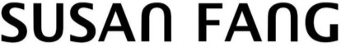
OUR CLIENTS
OUR CLIENTS

Slide 3
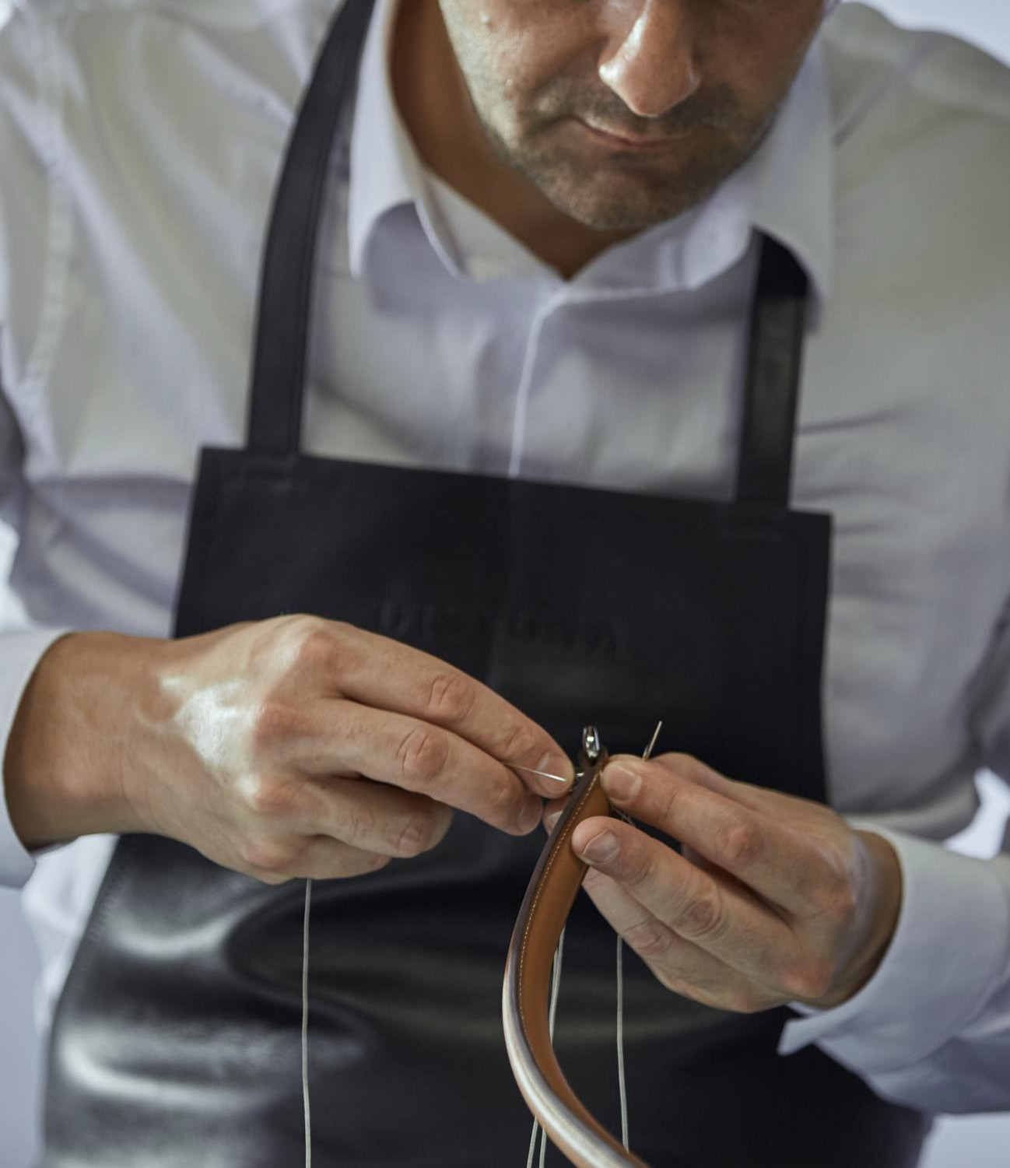
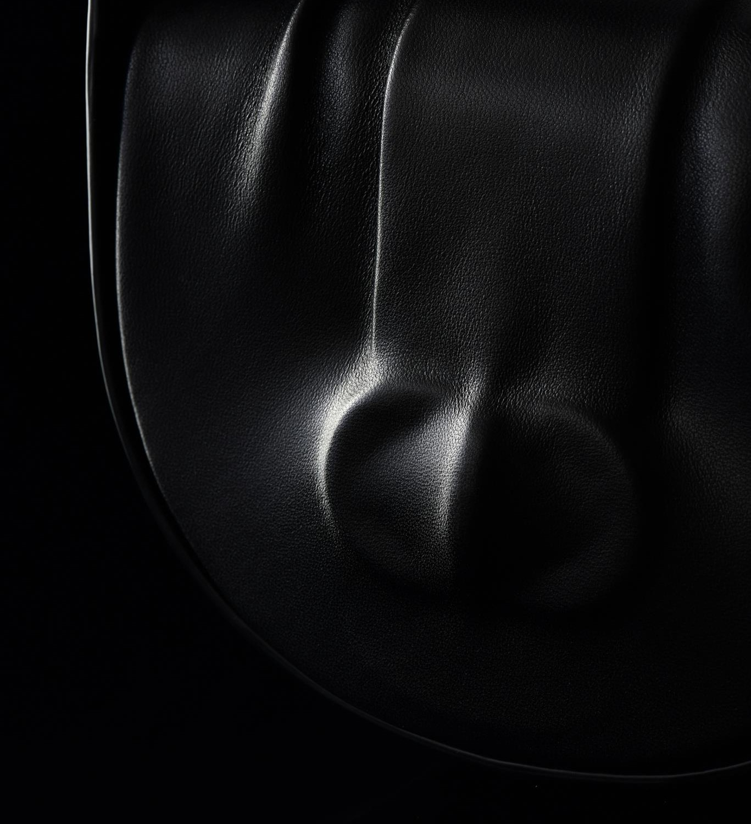
01. Mission
Ingenuity creates the beauty of art
02. Vision
To be the world's leading service platform for accessories
03. Value
Integrity and openness, embrace change, be proactive and collaborative

Slide 4


ESG
Collaboration Center supporting
Environment
Environmental protection：solar
system, rain-water recovery system
Responsible sourcing：material with ESG standard
Waste management: upcycling and recycling
Social
Air-conditioning and ventilating
system for all production line
Development of Human Capital:
health and education
Healthy Social and community relations
Governance
Openness and transparency within the community
Corporate Governance with good
ethics

Slide 5

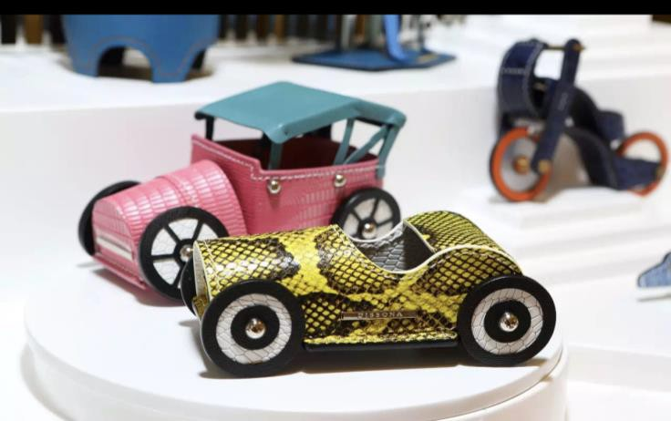
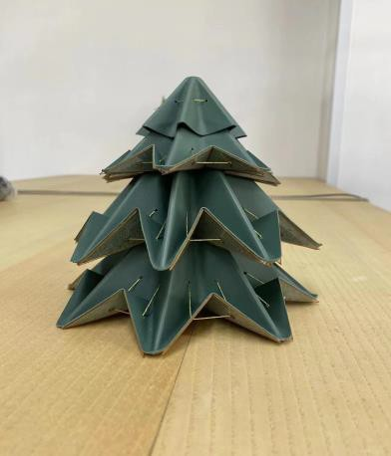
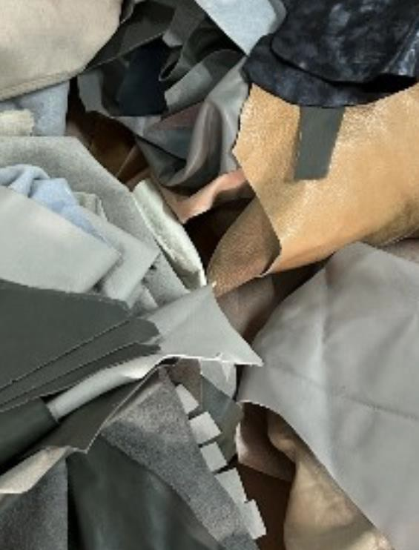


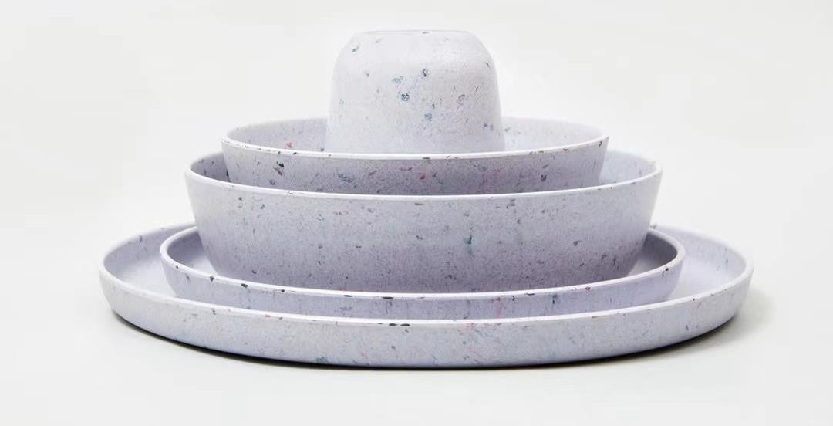

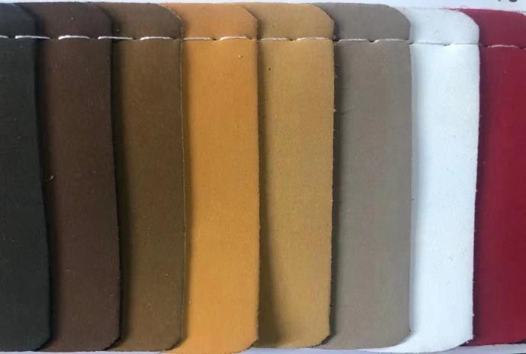

Sustainability
Upcycle from cutting waste to charms
FROM WASTE TO TREASURE
Recycle from cutting waste to life style product
Recycle leather

Slide 6











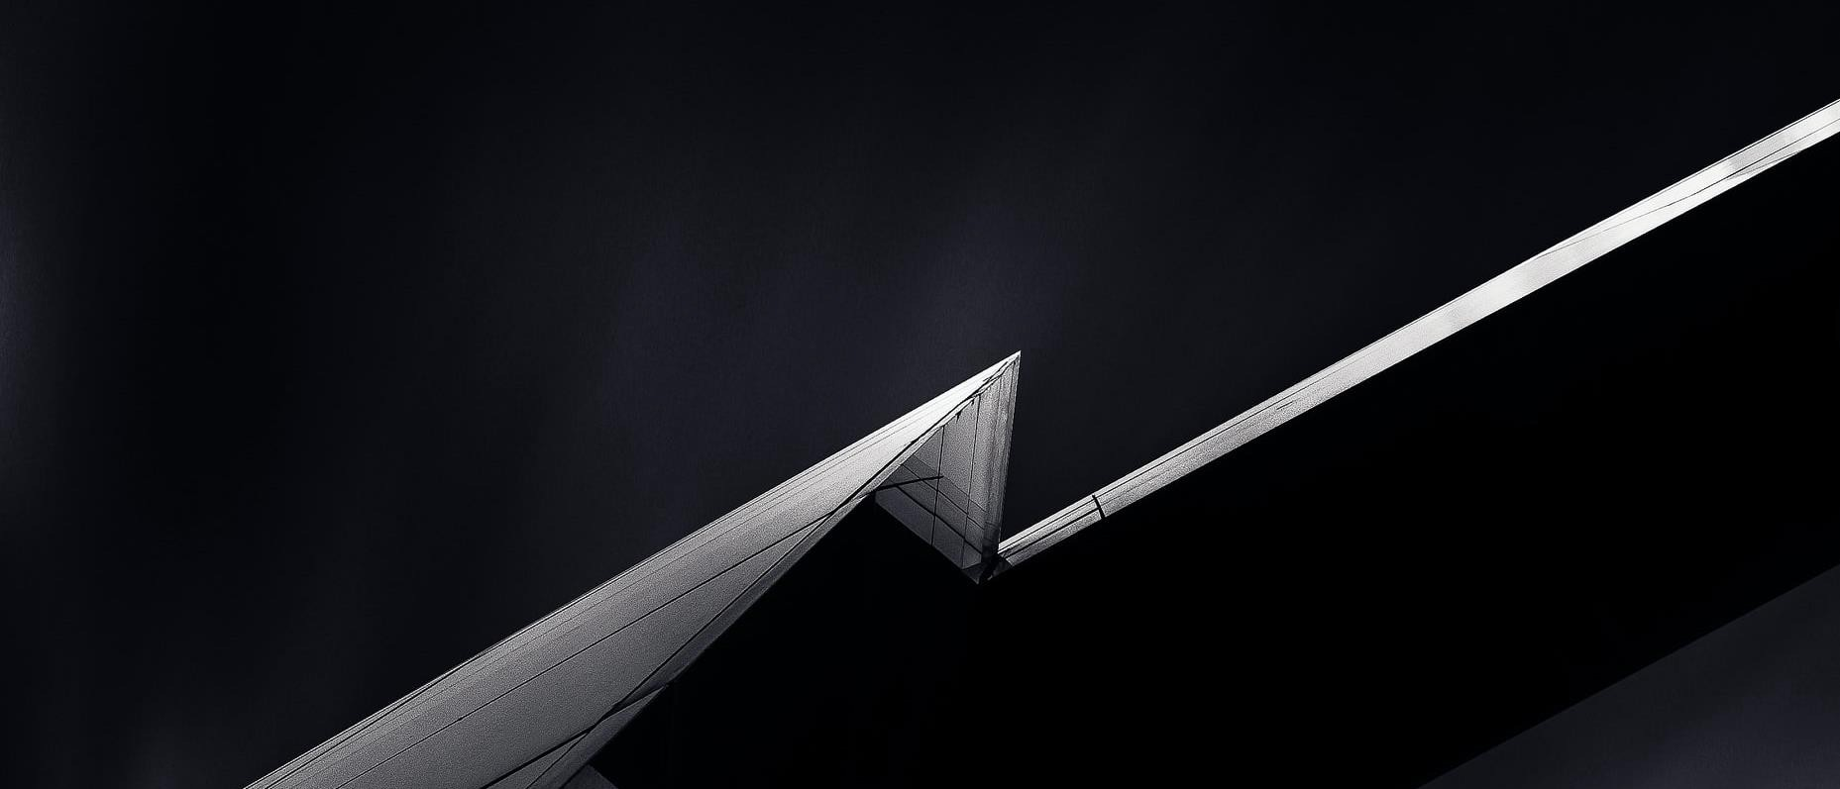


OUR JOURNEY
2024-2025Y
Available to R&D and Produce in
Italy China Cambodia
2023
2019
Sample room in Italy
Started Globalization project @Italy & Cambodia
Designer brands incubation
Increased investment in R&D and intelligent manufacturing equipment
2018
Dongguan Industrial park has landed in phases
Started smart manufacturing upgrade project
2011
Started Dongguan Industrial park Expanded Shenzhen production capacity to 2million pieces.
2008
1985
Founded DeArt； built R&D sample room
Shenzhen manufacturing center renovation
Key clients concentrated on affordable luxury brands

Slide 7
Core Strategy
Quality Excellence
Manufacturing Excellence
Practicing craftsmanship and lean production
Adhere to the customer as center, from products and services to achieve the best user experience
The CAPP intelligent process system is combined with the big data intelligent scheduling system
Visualize the entire production process
DeArt
Customer Insight
Digitalization
Strong experience in customer insights: from fashion trend to Chinese retail market performances
Support various cross-industry clients, emerging designer brands on R&D
Big data platform and micro-service platform dual- core drive
Collect and share big data with raw material suppliers and partners

Slide 8


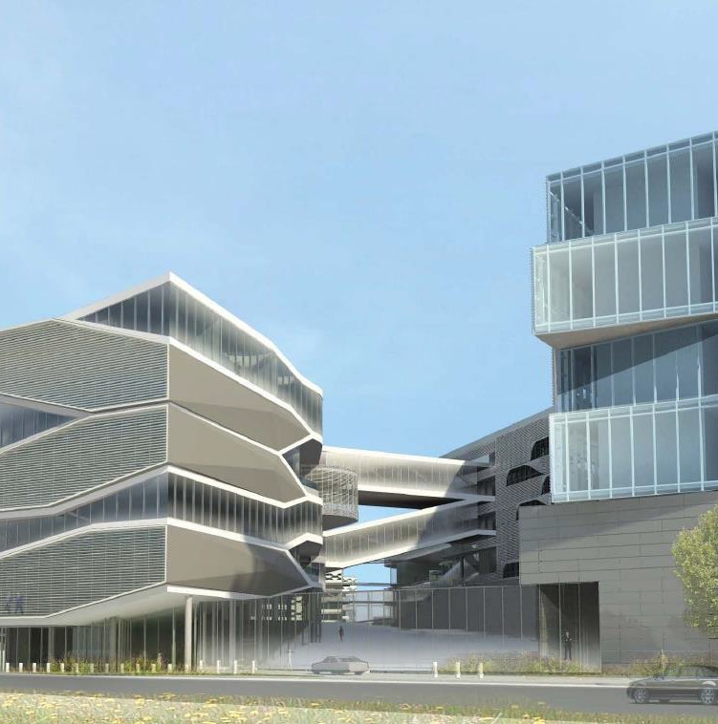
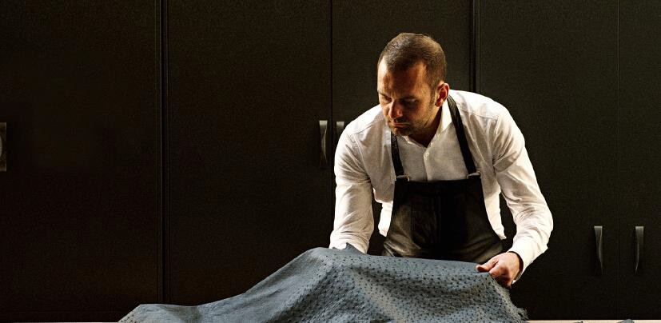
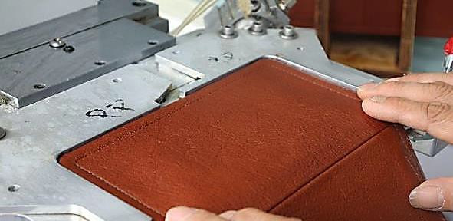
We provide customized solution
2
1
China for Global
High quality with smart and flexible production
Made in Italy
First-class products and service
3
Cambodia factory
Proficient and cost-effective production for mass market

Slide 9
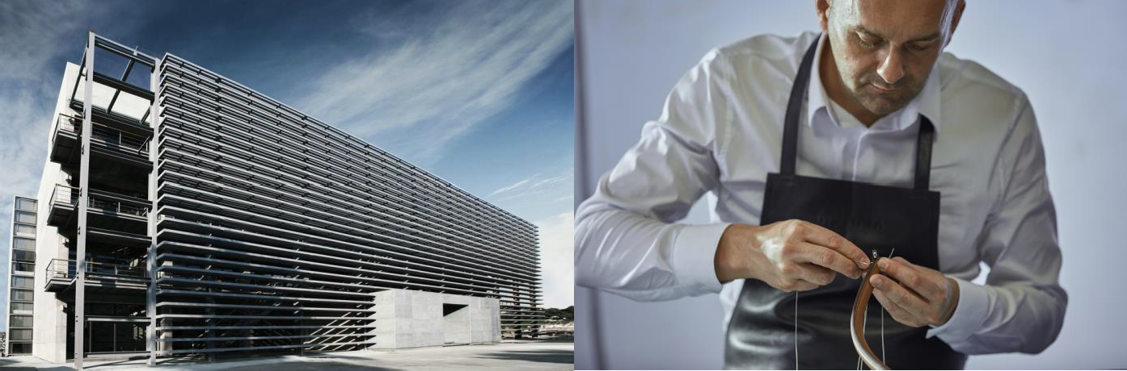
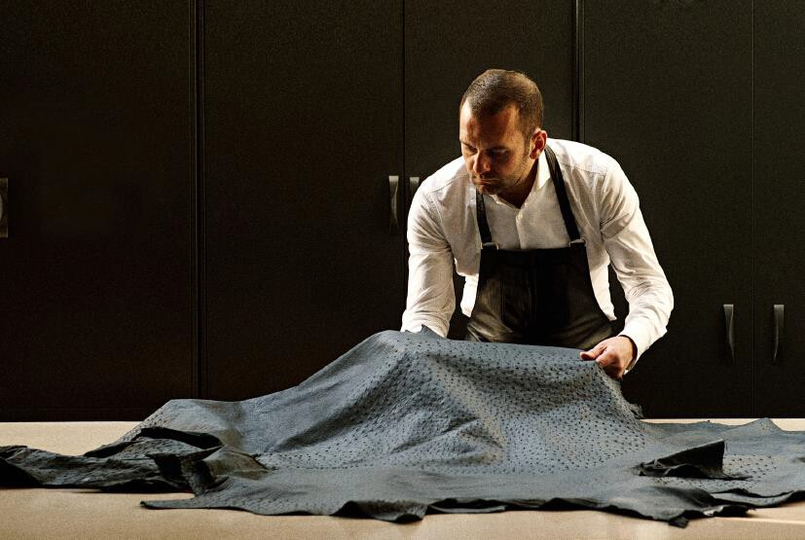
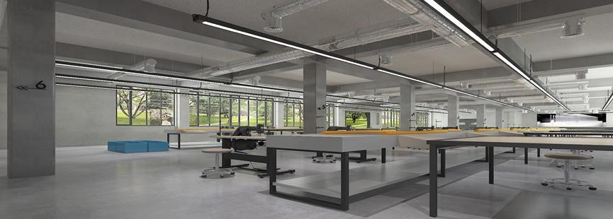
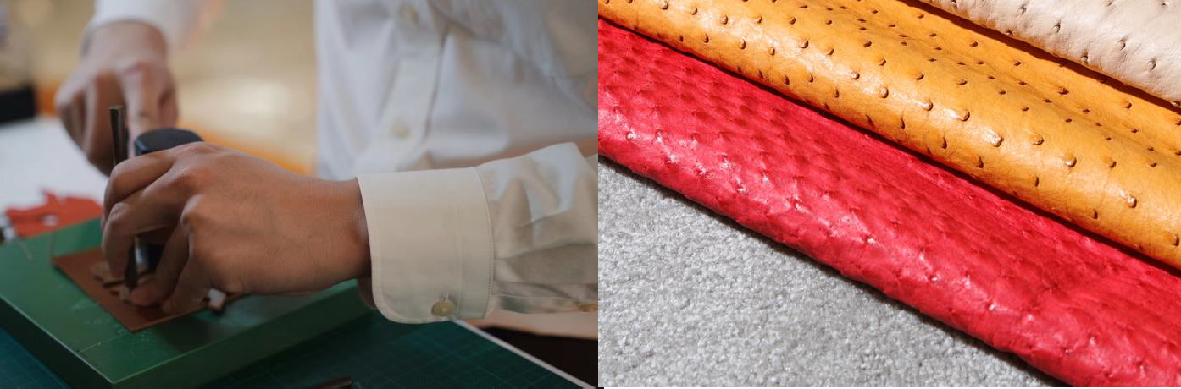
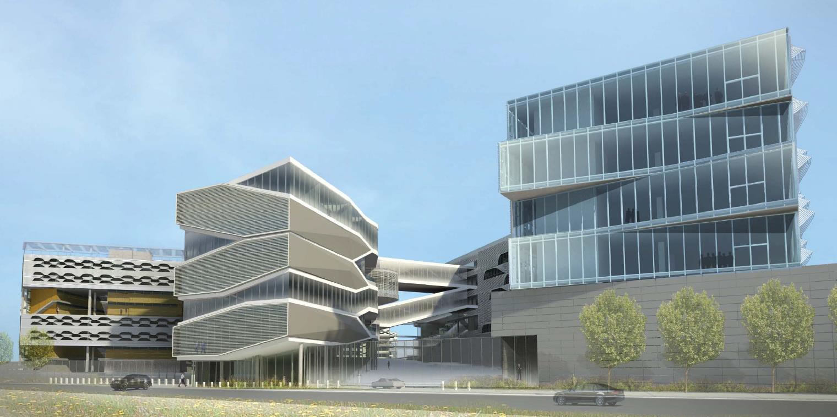
¹“China for Global”
DONGGUAN
Covers an area of 50,000 square meters, with a total construction area of nearly 120,000 square meters
Technicians：400+ ppl
SHENZHEN
Annual output of 2.2 million+ pieces
Construction area of ～50,000 square meters
Integrates design, R&D, production and sales
support.
2 leather handicraft PL, 5 PL, and 1 SLG PL.

Slide 10
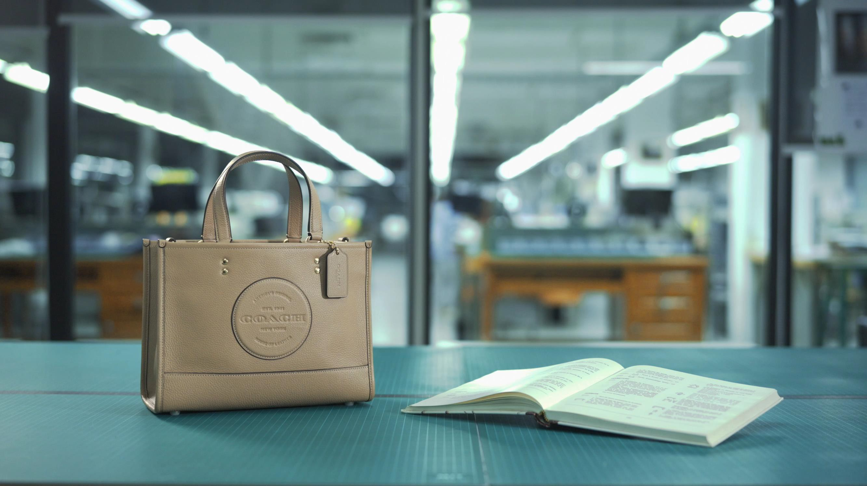
Smart production line overview
1

Slide 11

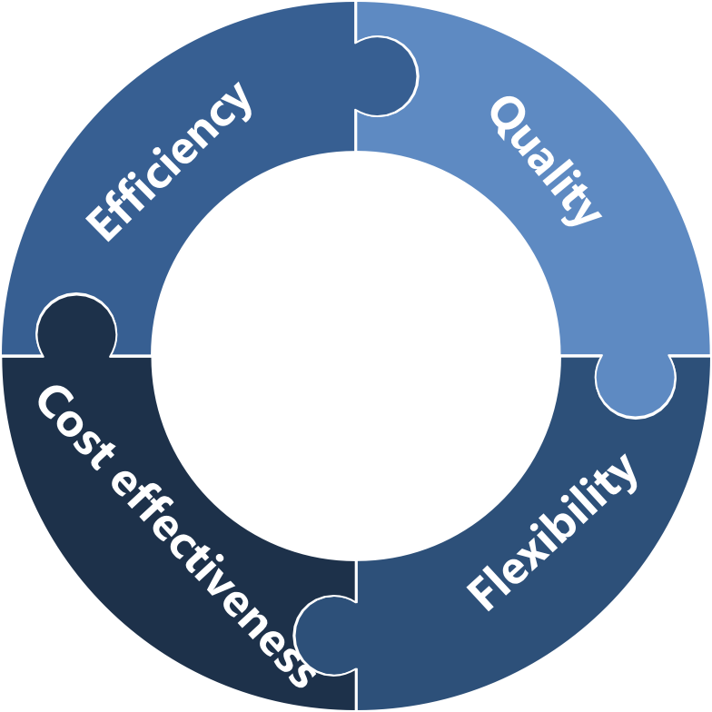






“China for Global”
1
“Advanced production —— high quality customized to client-specific standard, high productivity with smart production line, and flexible production for small-scale orders”
Close-to-market production
High efficiency for EC in China
Standardized working procedure
Clear workflow and well-rounded training
Advanced machinery to facilitate production
Handle novelty product at cost and quality
Control on long-term stable costing
Quick reaction to actual sales in
China
Ability to test styles

Slide 12


“Made in Italy”
2
Full process management
Trading company
in Italy
Local employee
coordination
Local employee
coordination
DEART ITALY
&
Order
Production
Examination
Full production process in Italy
Sample room and workshop
Capable of local development and small-scale production
JV factory in Italy
B.B.C PELLETTERIE s.r.l

Slide 13
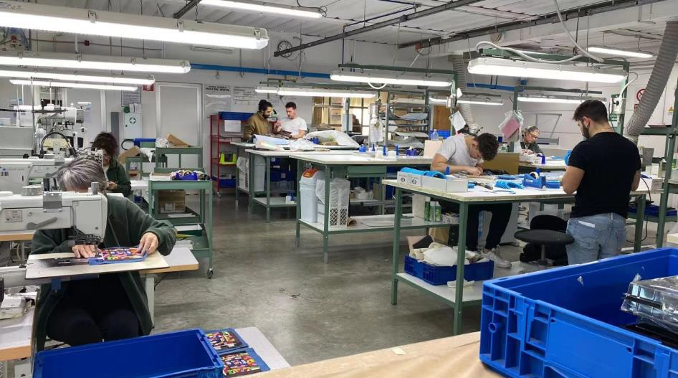
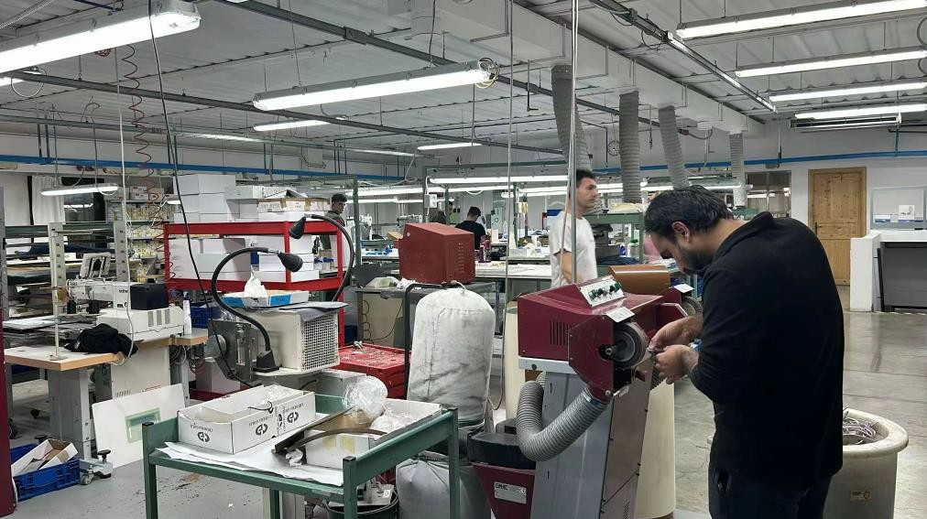
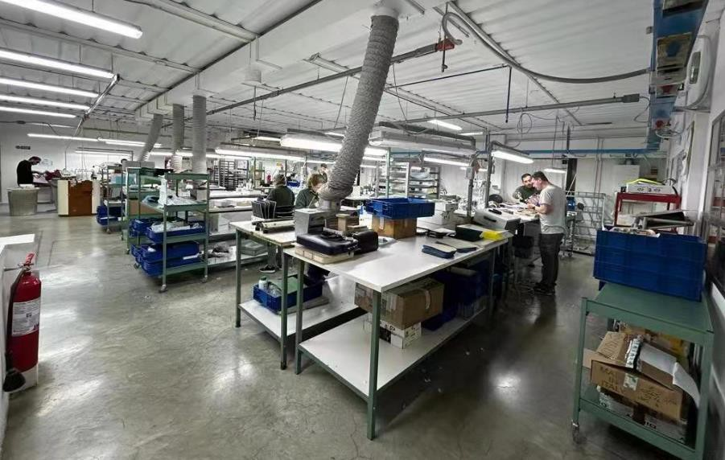
Italy Project - Workshop
2
B.B.C PELLETTERIE s.r.l

Slide 14
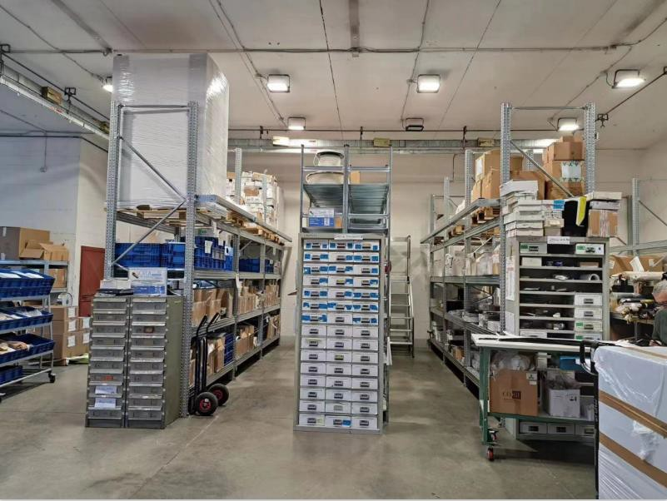
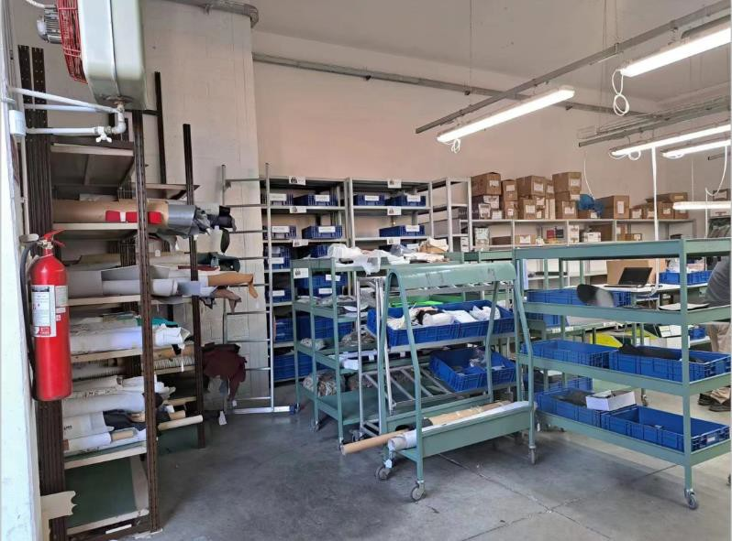
Italy Project – Warehouse
2
B.B.C PELLETTERIE s.r.l

Slide 15
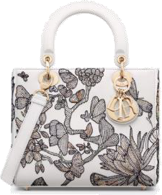
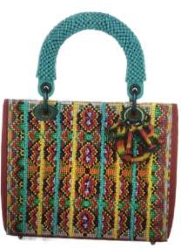
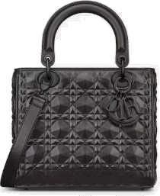
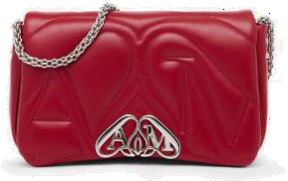
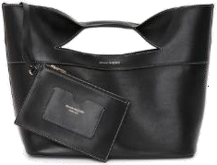
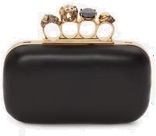
Italy Project – Production Styles
2
B.B.C PELLETTERIE s.r.l

Slide 16






“Cambodia JV”
3
Factory scale
Equipment
We provide multi- COO solution with competitive labor cost.
Laminating Machine
Laser Engrave Cutting
Machine
Cutting Paper Pattern Machine
(for computer paper pattern)
Automatic Fold Edge Machine
Automatic Zipper Teeth
Machine
Automatic Edge Paint Machine
Proficient workers
>1000
150K
Units monthly
Sufficient
capacity

Slide 17
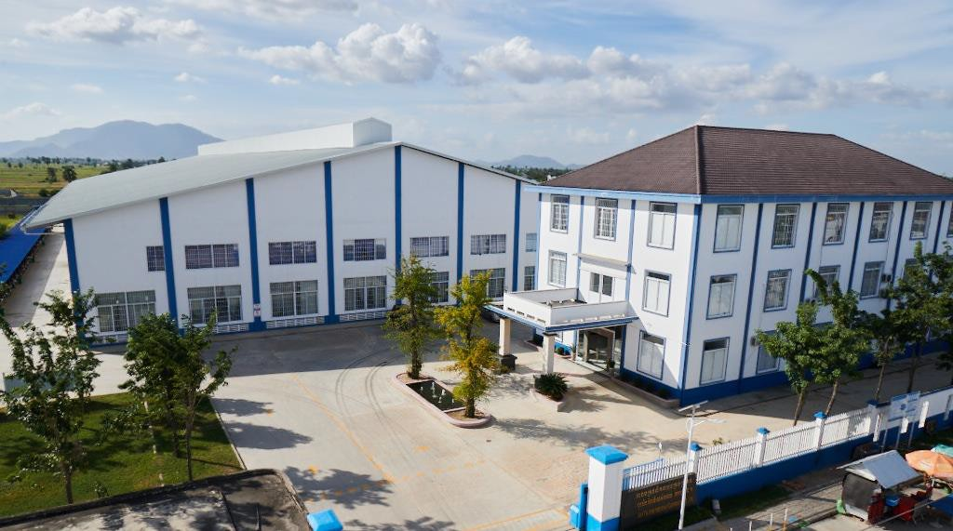
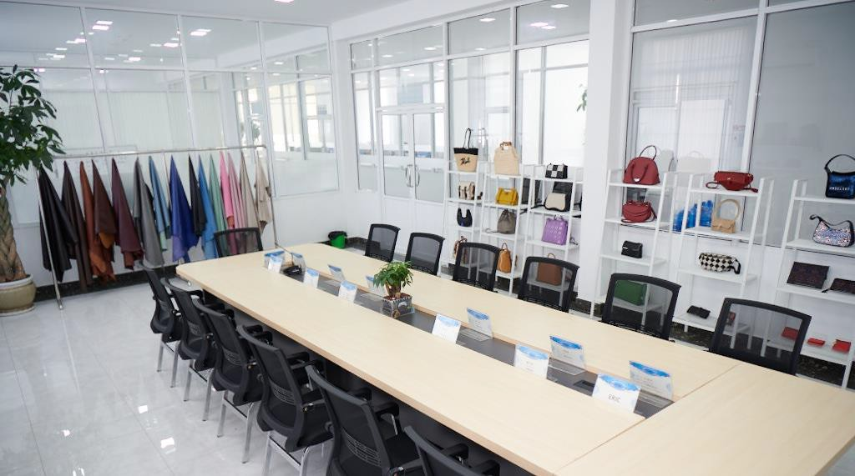
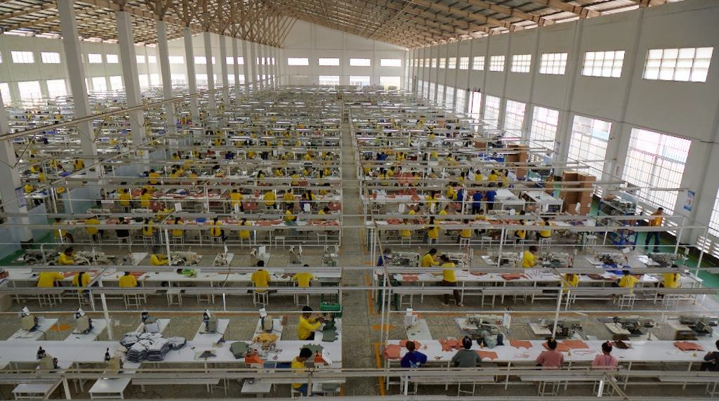
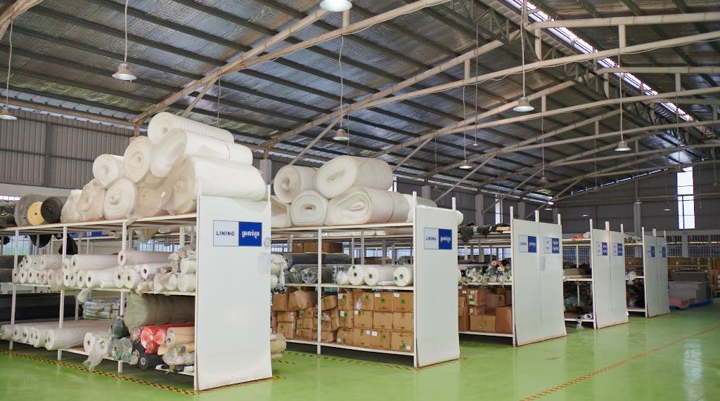
Factory overview
3

Slide 18
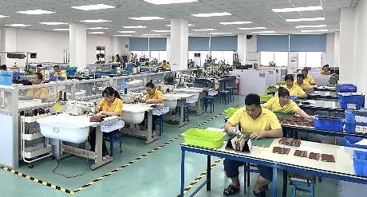
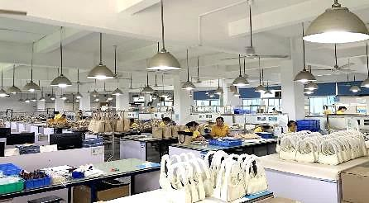
Production Line
3
Operation Centre include Engineering, Sourcing, Logistics, IQC/Testing , Production
Engineering Dept
Production Dept

Slide 19
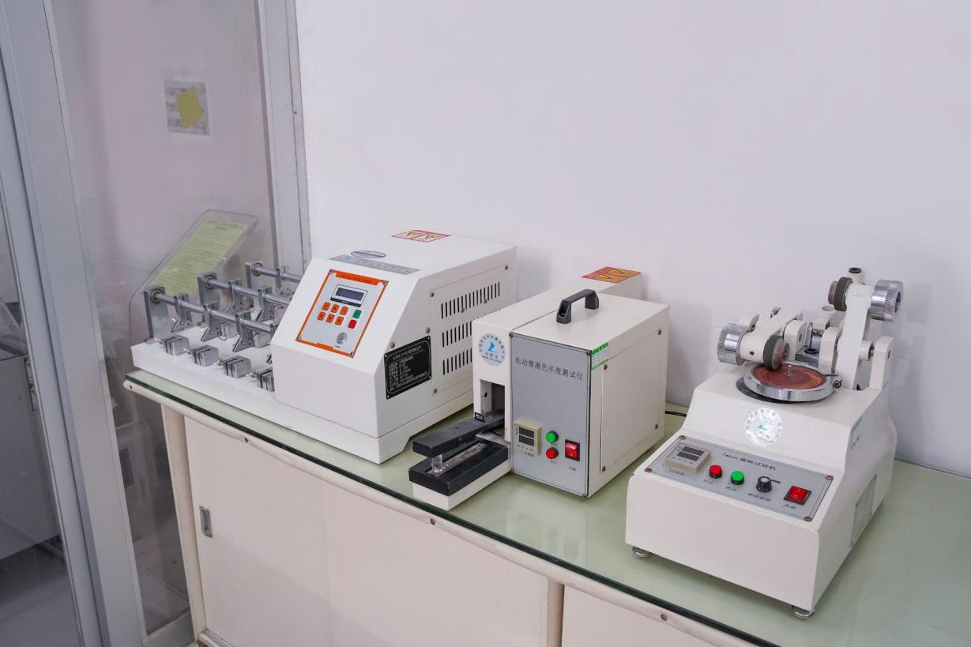
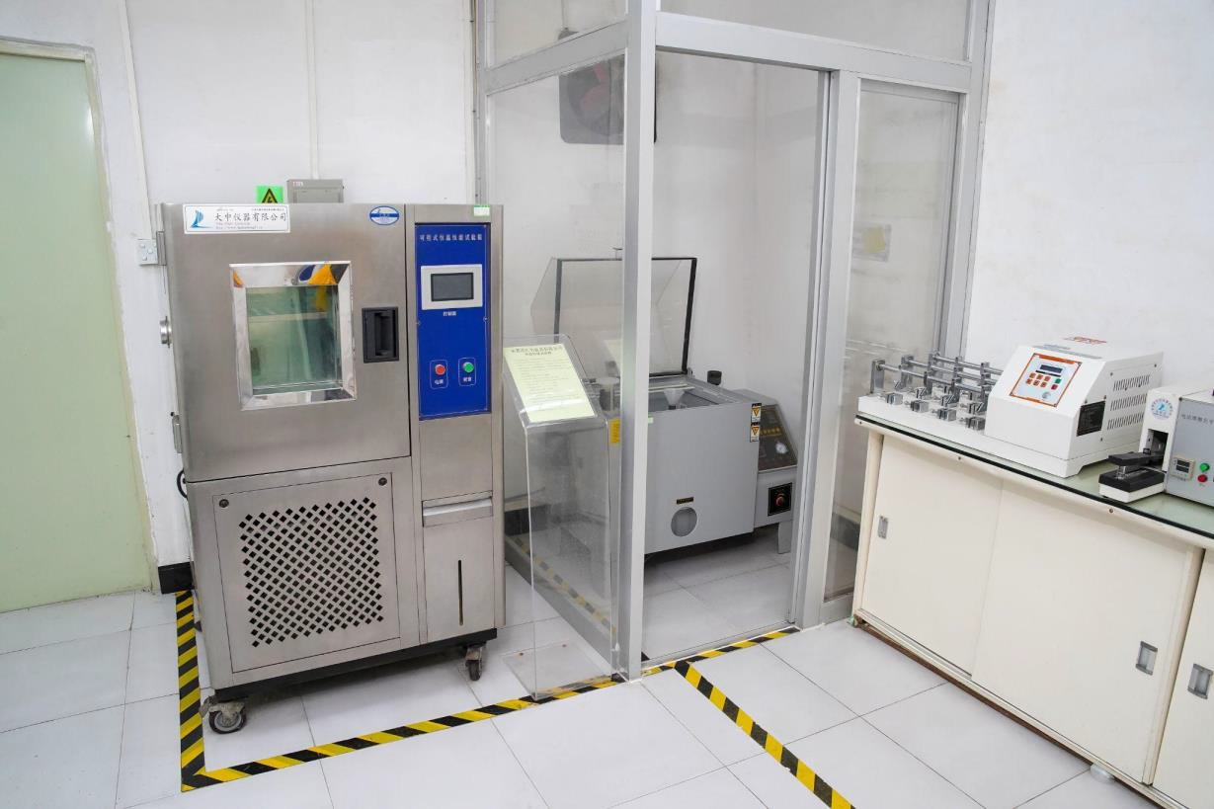


Laboratory
3
4
1
2
3
1. Flexing Test Machine
3. Abrasion Machine
2. Crocking Machine
4. Oven Test Machine

Slide 20




Next focus - Keep improving ourselves
Intelligent production breakthrough
Customer service satisfaction
Cost and efficiency control optimization
Further Globalization
With MES, the production progress upgrade to real-time process control, visualization, digital management and automatic accounting Create E2E production plans, man-machine requirements Complete system deployment, SAP ERP + MES + WMS + QMS + APS core modules | Provide flexible and efficient services Strengthen R&D capabilities Customized solution | Excavate cost reduction space from the design stage Strengthen supplier management and reduce procurement costs Inventory and saving of non-production costs | Refine techniques and enhance quality based on learnings from Italian factory Promote advanced production to improve efficiency and minimize the impact of labor cost inflation

Slide 21
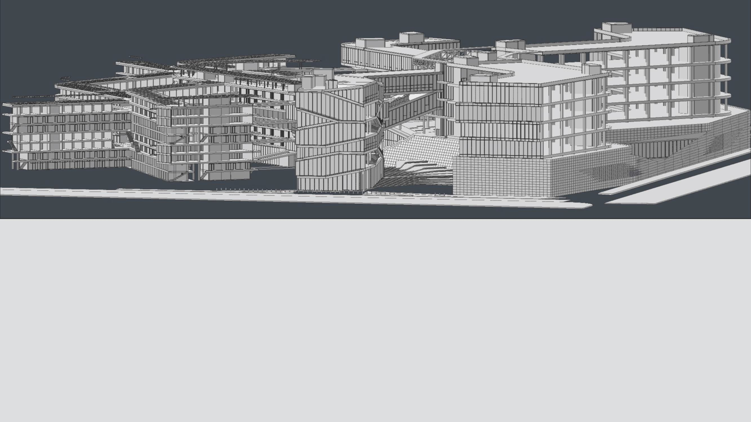
Our New Facility-
DeArt Creative Industry Park

Slide 22
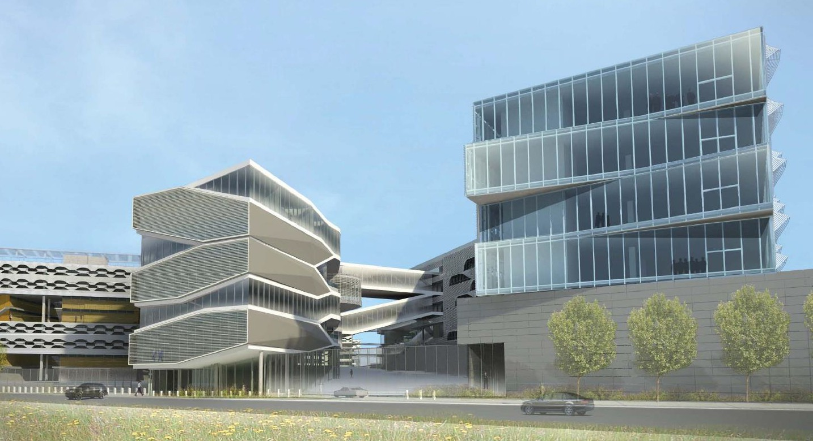
Main entrance
INDUSTRIAL PARK
located beside Songshan Lake in Dongguan
50,000 square meters and has a total construction area of nearly 120,000 square meters
designed by DILLER SCOFIDIO + RENFRO, a US-based architectural firm nominated for the Pritzker Prize.

Slide 23
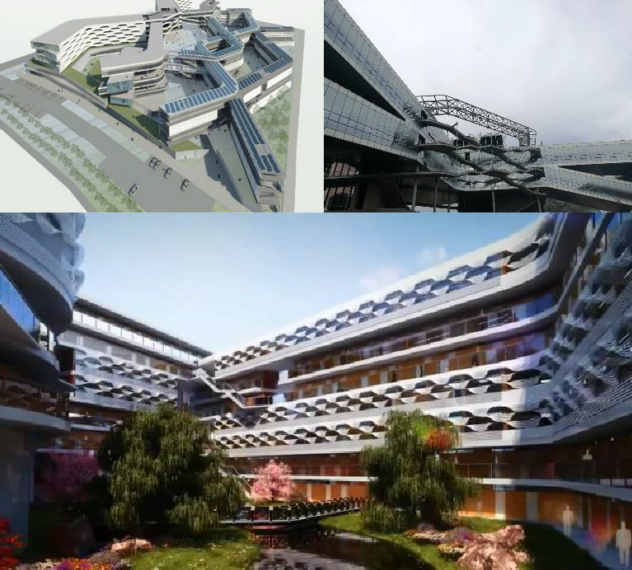
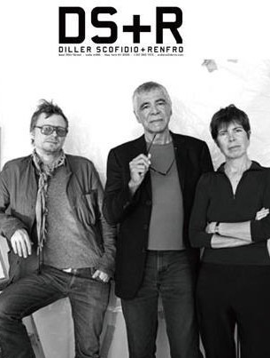
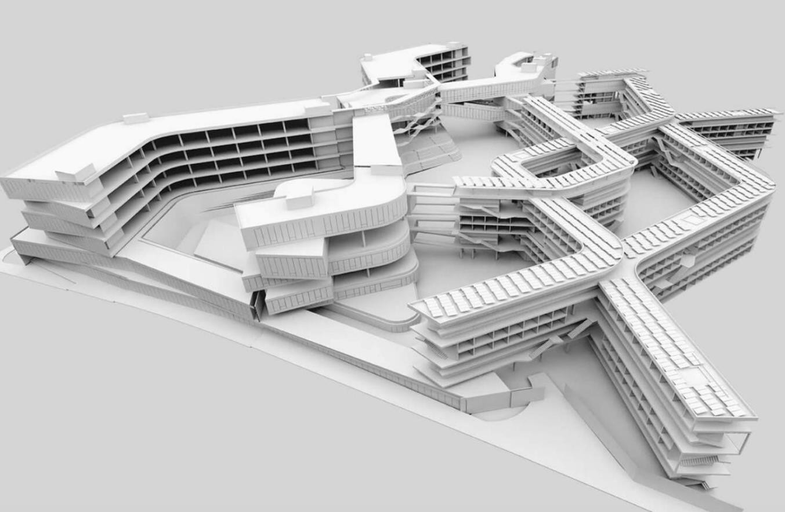
Architecture team
Hand in hand

Slide 24
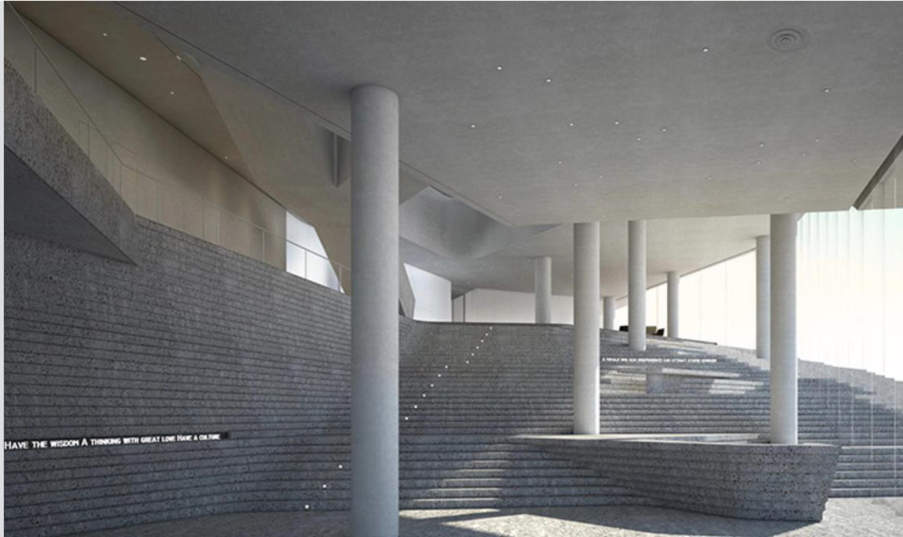
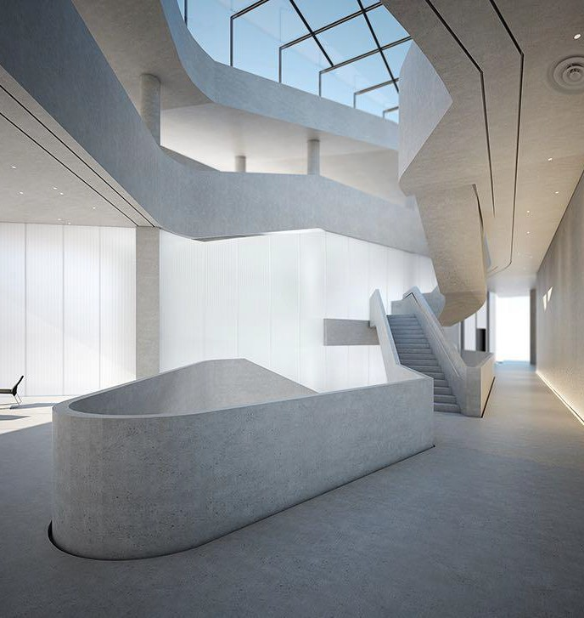
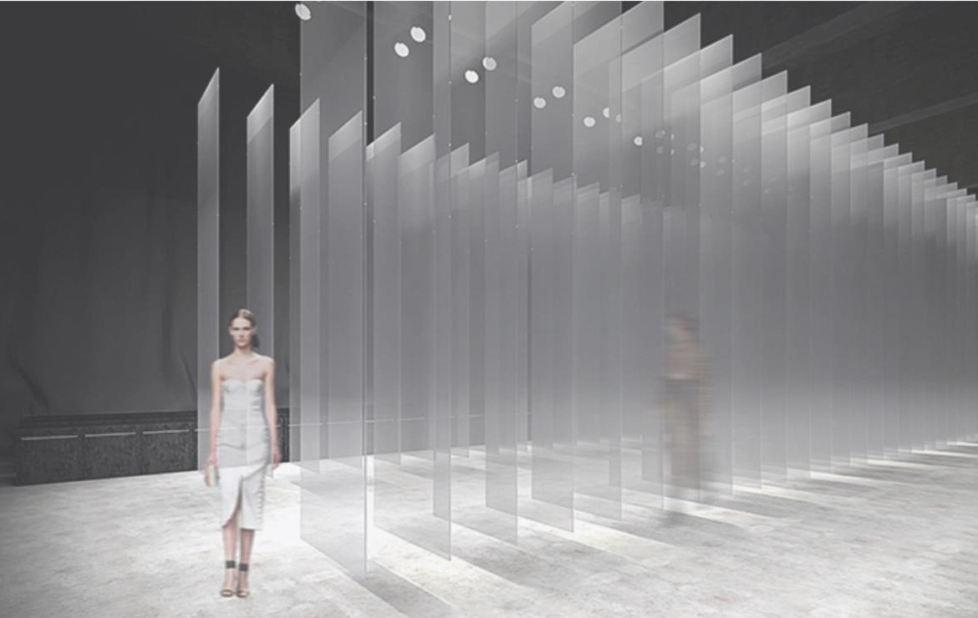
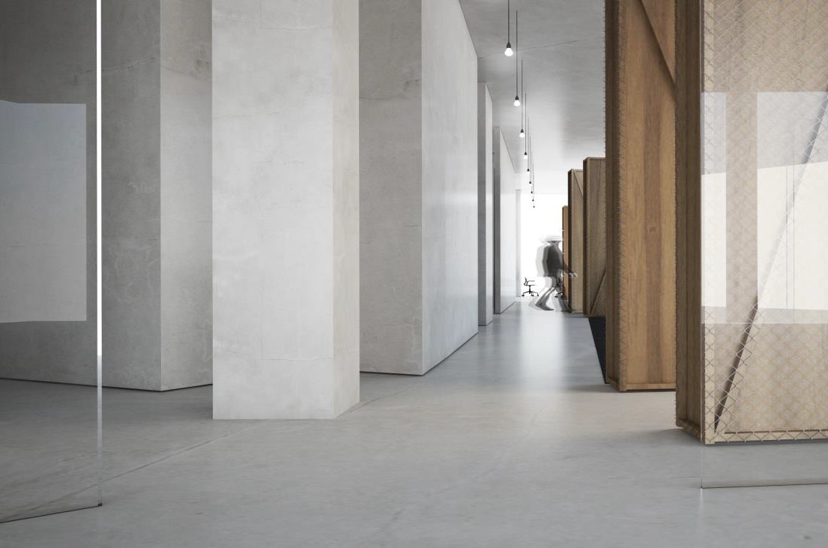
Reception
Show room
Meeting room

Slide 25
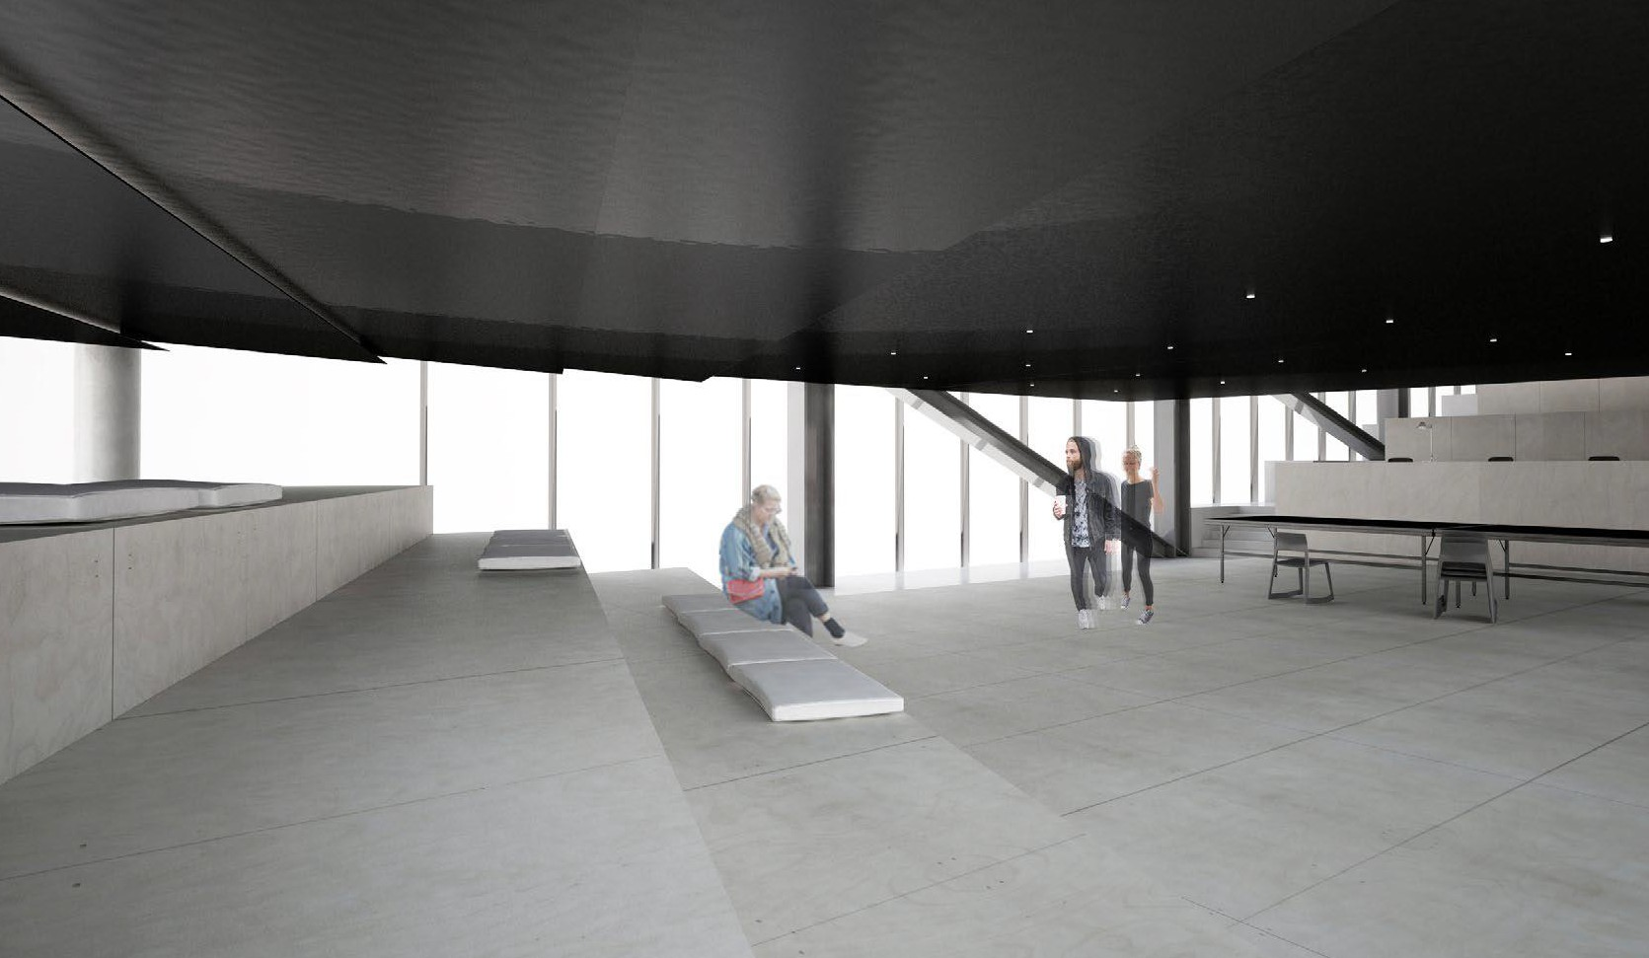
Design office

Slide 26
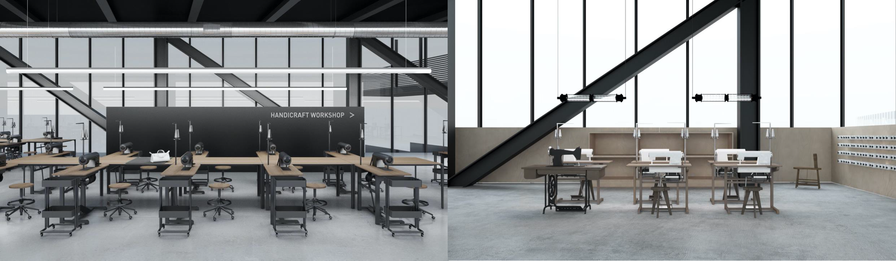
Sample room

Slide 27


Cinema
INDUSTRIAL PARK
More than 60% of the park's floor space is used to provide a comfortable living environment for our employees and promote closer social interaction within the company outside of work.
Library
environmental protection concept which includes a solar central hot water system, chilled water system of HVAC and a rainwater recovery system.

Slide 28


We provide：
Dormitory with individual window

Slide 29


We provide：
Dining hall

Slide 30

THANK YOU

